Slide 1

DBP 2018 → The Recruitment process
DOM
Christine Frank,
Adnan Morshed, Lauren Pfirten,
Tatevik Brändlin

Slide 2
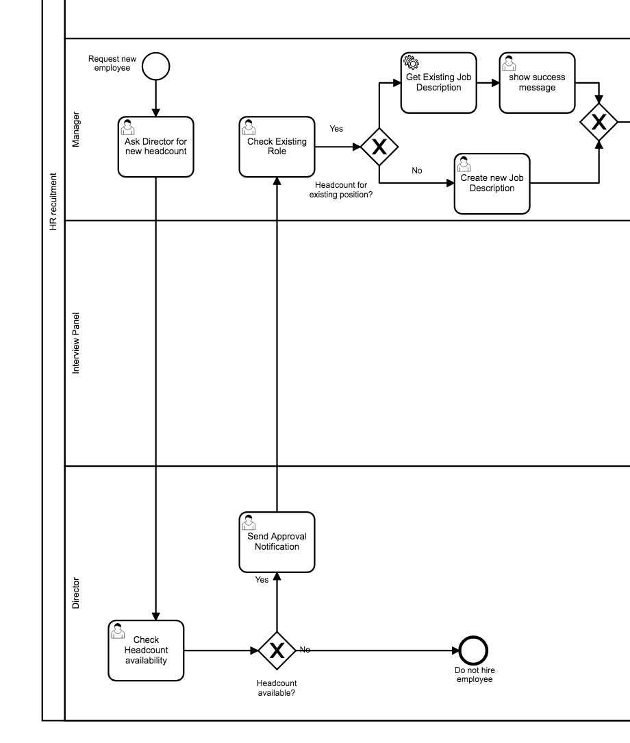
Start of the process
- Request for new Employee
Depending on the decision of the Director: the process either continuous or Ends with the rejection.

Slide 3
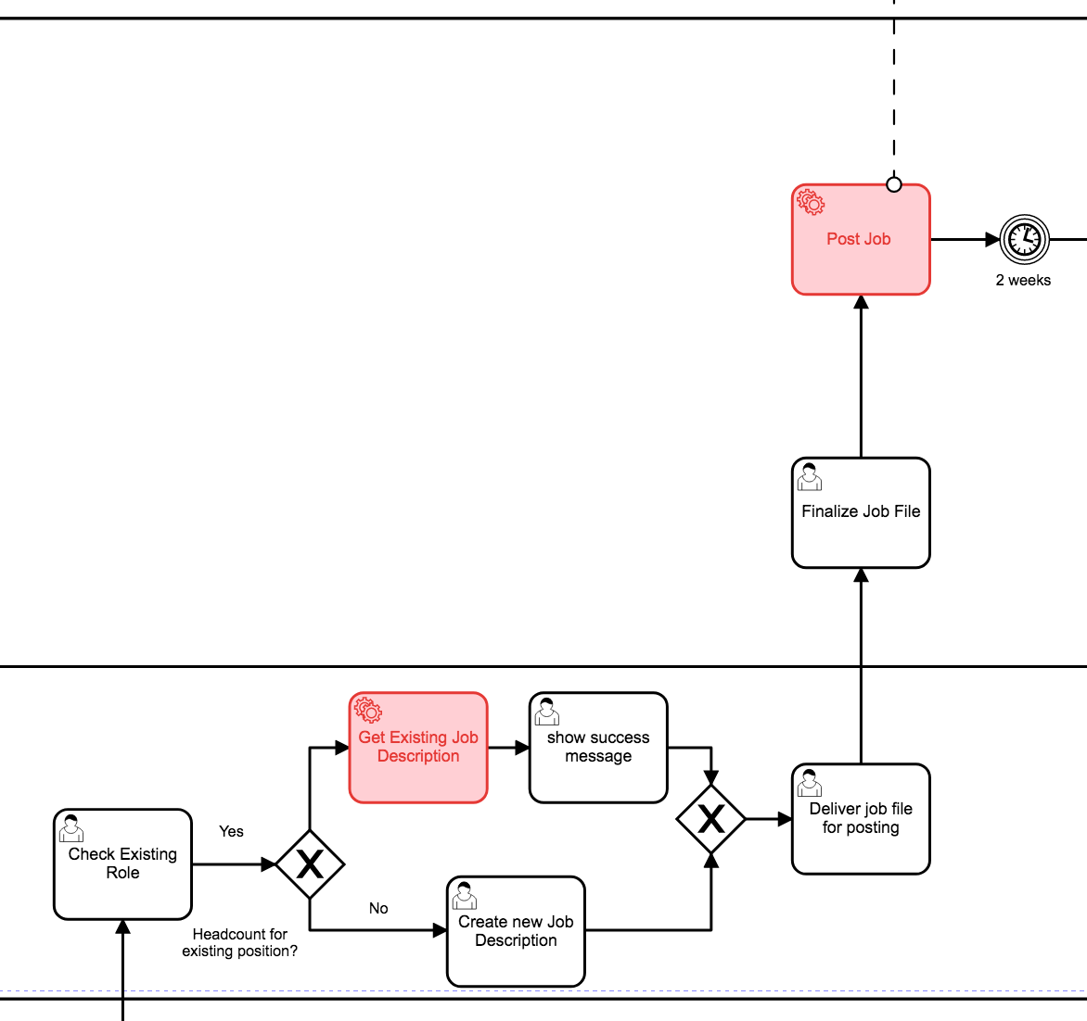
When Job description is ready it can be posted into the companies Webpage.
After the posting applications will be collected for two weeks
After the approval notification arrives at the HR Department, The HR Employee has to either create a new job description or retrieve already existing job description from a google sheet.

Slide 4
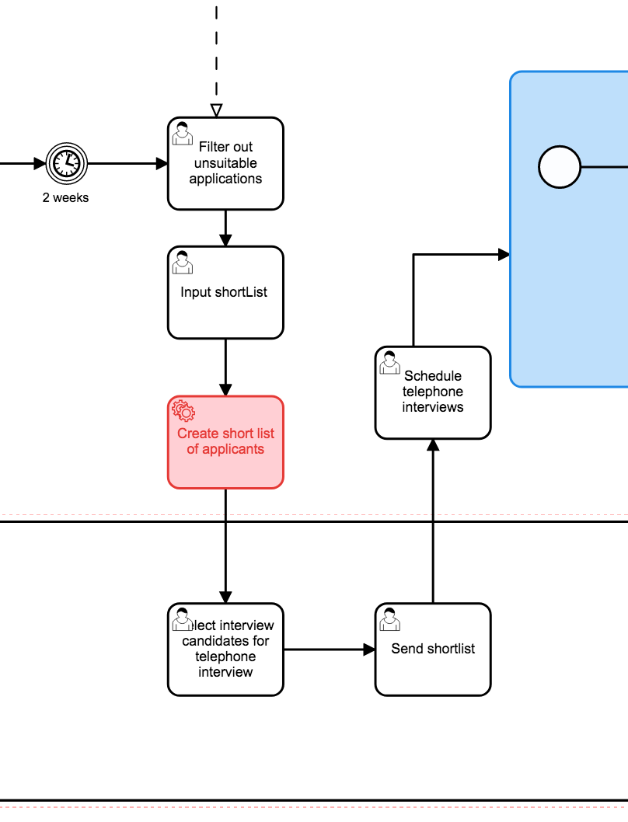
After two weeks, the candidates will be filtered out from the HR Employee.
The HR employee updates the list with all applications and then updates it the list itself
After sorting the HR Employee prepares the Phone-Interviews
The Manager checks the Shortlist provided by the HR Employee and sort outs wanted candidates for for the planed telephone interview

Slide 5
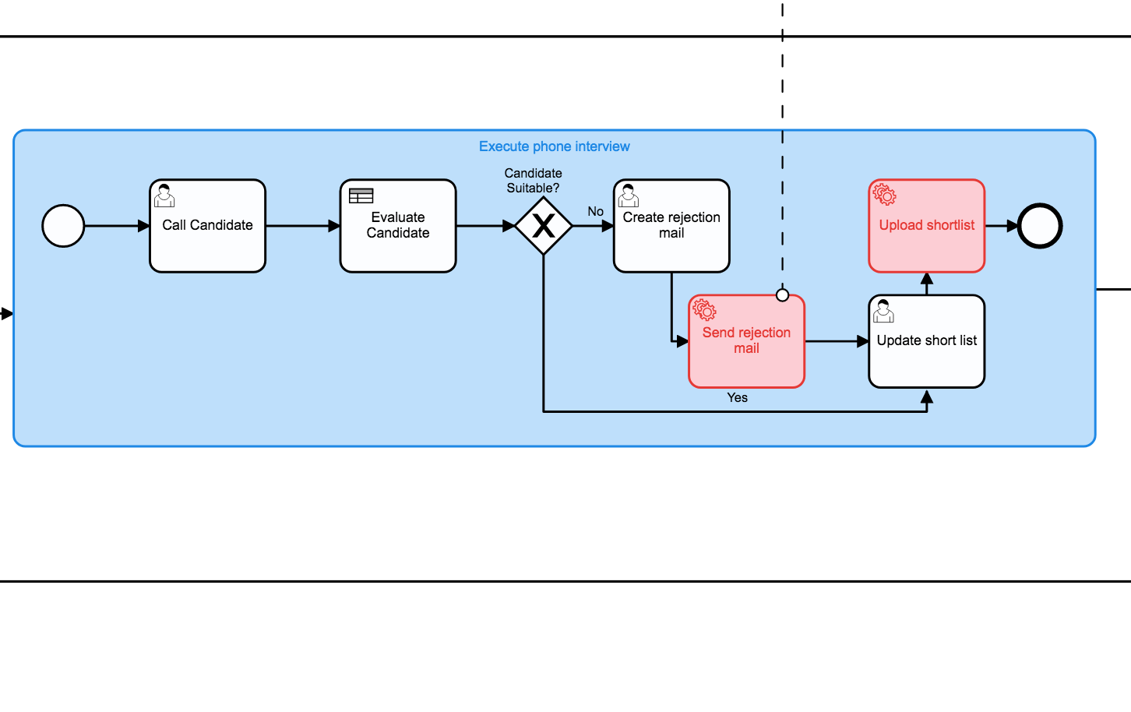
Execute phone call
“Execute Phone Call” is a Subprocess which is executed many times. Within the subprocess the HR Employee evaluates the candidates and sort outs unsuitable candidates.

Slide 6
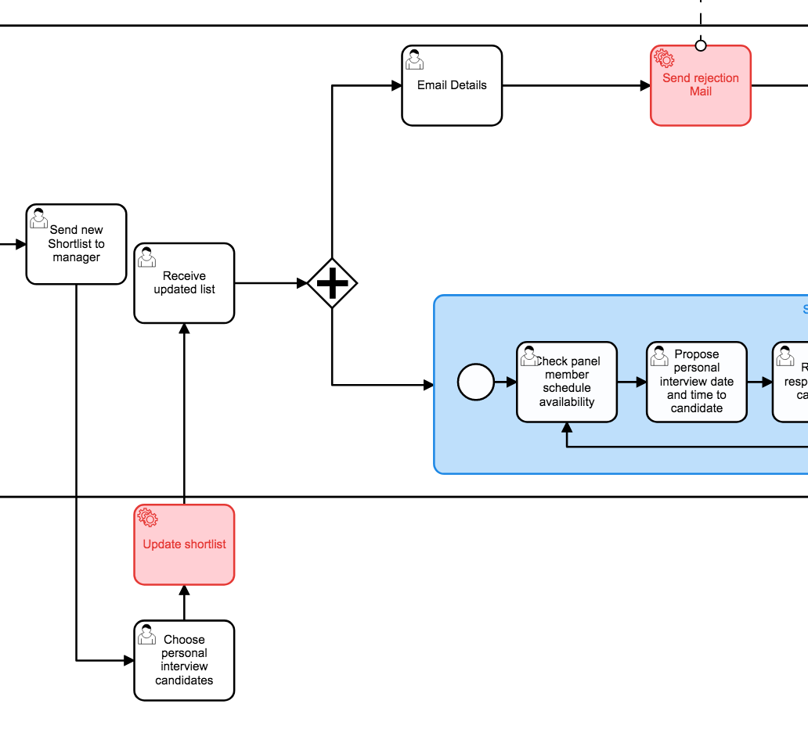
Candidates will be notified based on the new list. Either through a rejection mail or request for a personal interview
The sorted list is then send to the Manager who chooses candidates for personal interviews. The updated list is then send back to the HR Employee

Slide 7
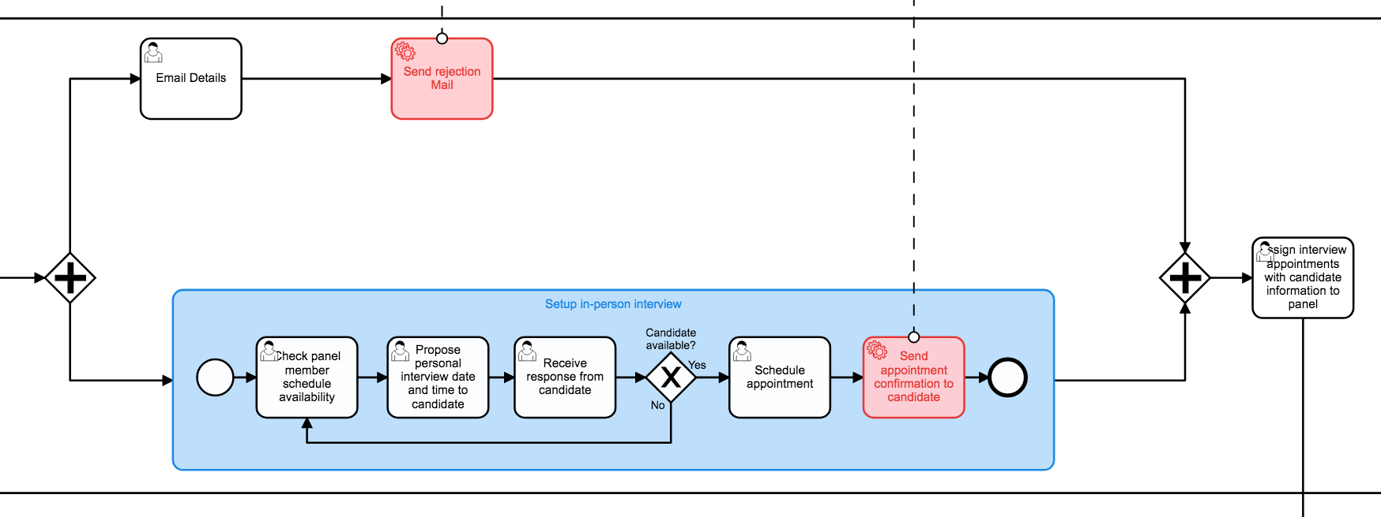
Rejection Email is send to the candidate
Setup in-person interview
Within the subprocess “Setup in-person interview“ dates for personal interview are scheduled.

Slide 8
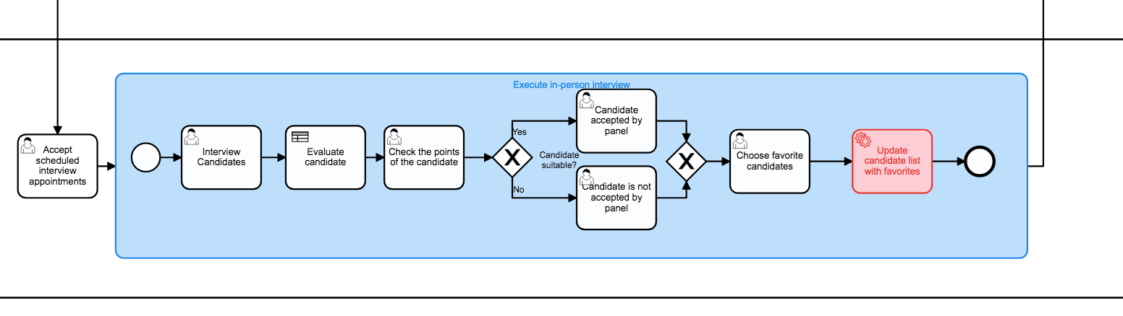
After time/date acceptance of the interview panel, the interview panel executes the personal interviews
Within the Subprocess „Execute un-person“ interview“ the candidates are validated. At the end of the process the candidate list is updated.

Slide 9
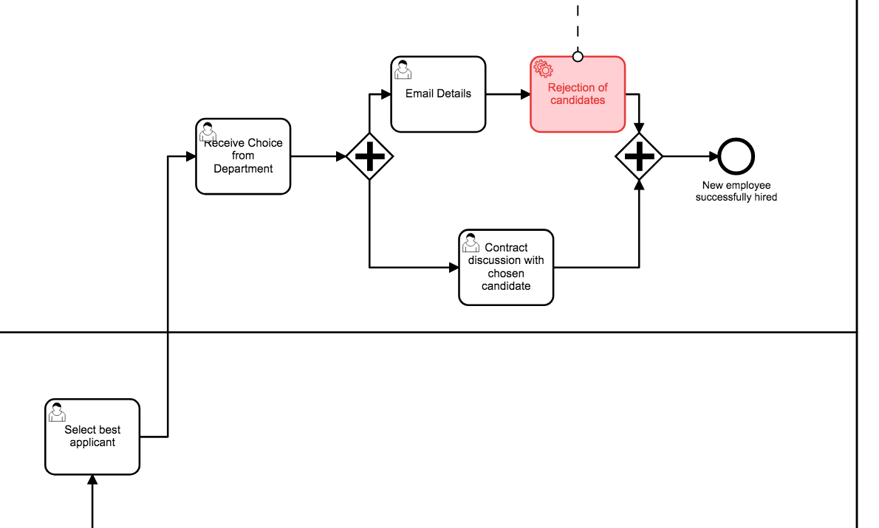
The process ends with the successful hiring of new employee
The HR employee then sends rejection email to selected candidates and prepares contract for the new employee
After the validation of the candidates the best candidate is selected for the open position

